Slide 1
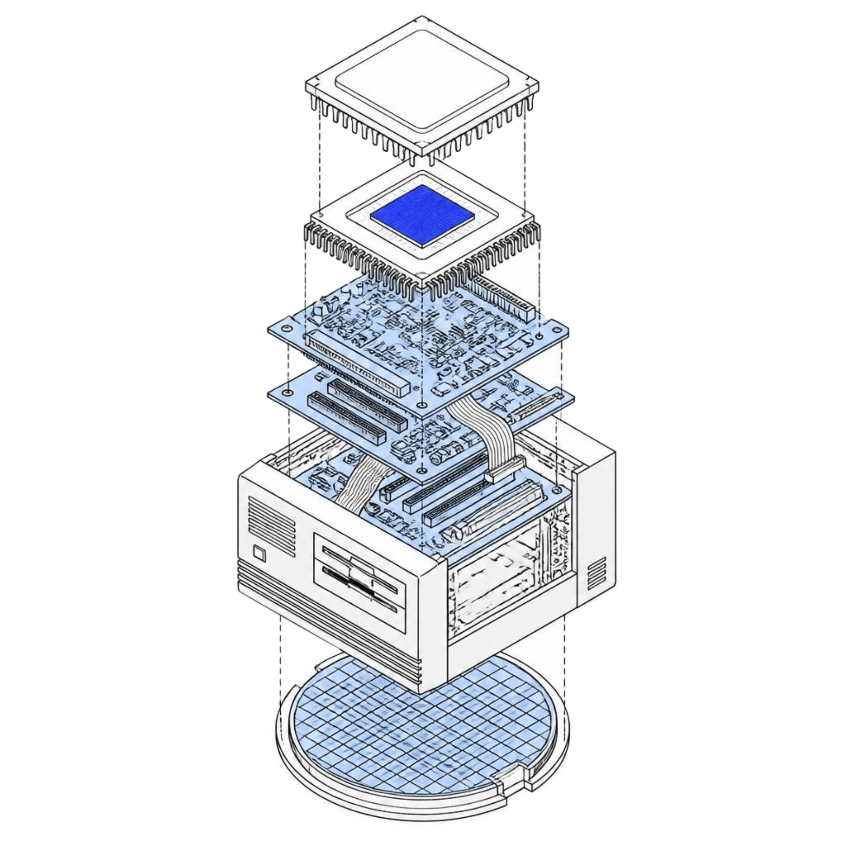
GLOBAL TECH HISTORY · 1980–1998
"The Cold War Is Over and You Have Won"
How Silicon Valley outlasted Tokyo and Moscow
SEMICONDUCTORS · CAPITAL · ARCHITECTURE
HISTORICAL RETROSPECTIVE
Notes:
Welcome everyone. Today we examine one of the sharpest reversals in modern industrial history: how Japan dominated global semiconductor memory in the 1980s, why that dominance broke, and how Silicon Valley emerged as the decisive victor of the technological Cold War.

Slide 2
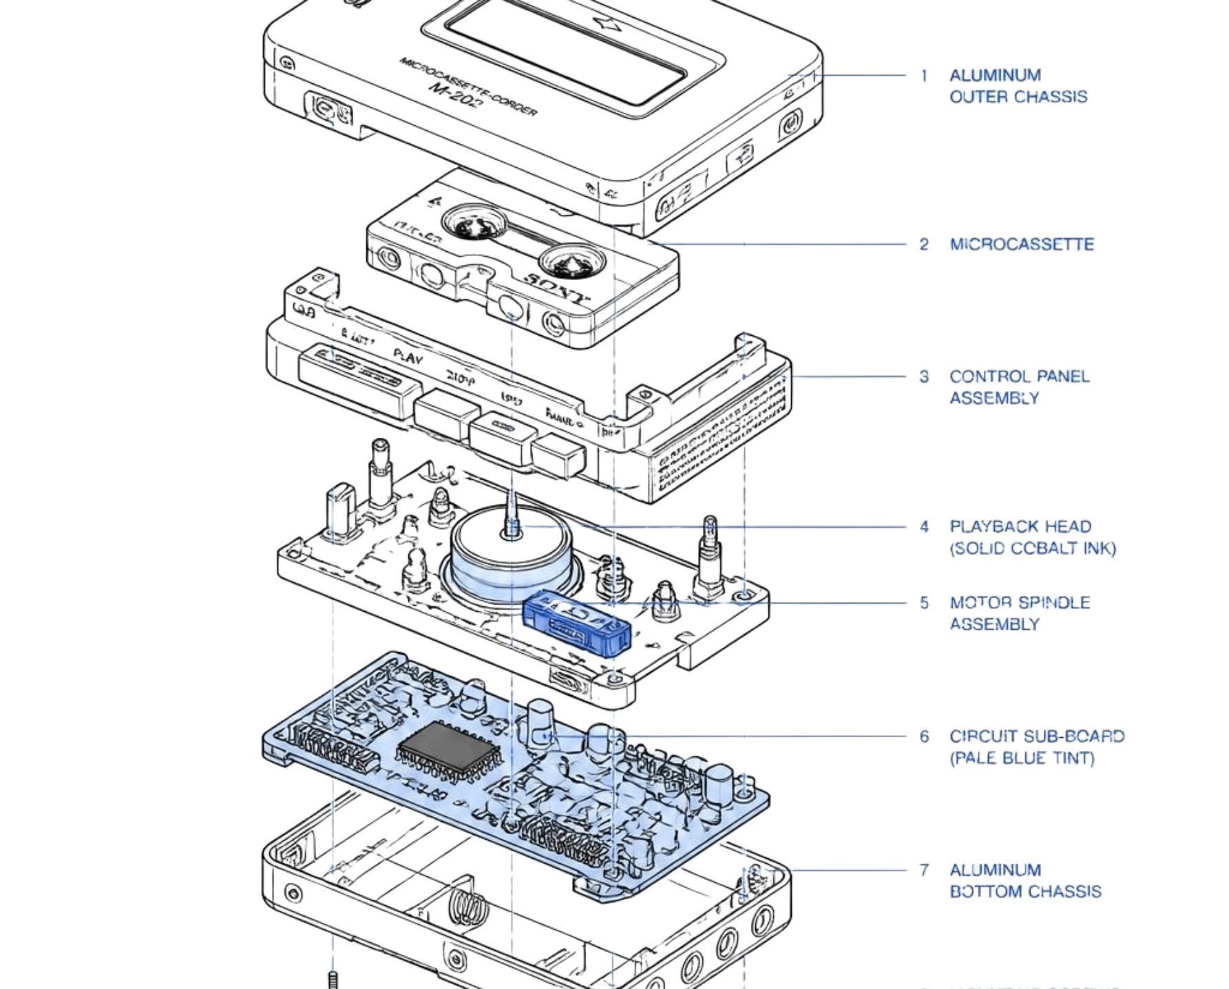
Japan looked unstoppable in the 1980s
THE RISE
"Japan as Number One"
Sony's Walkman and consumer electronics made Japan rich and helped make Japanese manufacturing the world standard for quality.
CHIP DOMINANCE
The DRAM empire
Memory chips became national pride. State-backed consortia and relentless fab efficiency pushed global competitors to the brink.
PRECISION HARDWARE · HIGH-YIELD SILICON
Notes:
In the 1980s, Ezra Vogel's book 'Japan as Number One' reflected global consensus. Japanese conglomerates mastered high-yield manufacturing, while DRAM memory chips established unmatched industrial dominance.

Slide 3
Japan's chipmakers made the wrong bets
COMMODITIZATION
MISSED INNOVATION
PLATFORM SHIFT
DRAM overcrowding
Flash ignored
The PC revolution
Every major Japanese conglomerate piled into identical memory chips, driving margins down to zero.
Toshiba researcher Fujio Masuoka invented flash memory, but leadership stalled while Intel commercialized it.
Japan optimized chips for mainframe reliability, missing the explosion of desktop PCs and microprocessors.
CASE ANALYSIS: SEMICONDUCTOR STRATEGY 1985–1995
Notes:
Notice the three fatal strategic errors: memory commoditization destroyed pricing power, internal inertia allowed Intel to seize flash memory, and corporate focus remained locked on mainframes while Silicon Valley built the PC standard.

